Slide 1
IoT-Based Vital Sign Monitoring System
Authors: Gabriel Prince D, Arjun MP, Kanchana R, Kharihara Sudhan P
Affiliation: Sri Sivasubramaniya Nadar College of Engineering, Chennai, India
Emails: gabrielprince2320060@ssn.edu.in, arjun2320047@ssn.edu.in, rkanch@ssn.edu.in, khariharasudhan2320078@ssn.edu.in

Slide 2
Abstract
Increasing demand for accessible, continuous healthcare, especially for aging and rural populations.
Proposed IoT-based system monitors heart rate, body temperature, and blood pressure non-invasively.
Uses ESP32 microcontroller with low power consumption and wireless communication.
Employs Pulse Transit Time (PTT) algorithm for cuffless blood pressure estimation.
Data transmitted to secure cloud platform with intuitive dashboard.
System is scalable, energy-efficient, affordable, suitable for home and resource-constrained settings.
Experimental results show accuracy comparable to clinical standards.

Slide 3
Introduction
Challenges: Aging populations, chronic diseases, lack of rural healthcare infrastructure.
Need for continuous, remote health monitoring.
IoT technologies enable real-time physiological data acquisition and remote supervision.
System combines Arduino UNO for sensor interfacing and ESP32 for wireless communication and display.
PTT-based cuffless blood pressure monitoring enhances comfort and usability.

Slide 4
Literature Review
Prior IoT health systems often limited by single parameter monitoring, cloud dependence, or high power usage.
Our system integrates multiple sensors: ECG, SpO2, temperature, motion.
Uses local processing on ESP32 to reduce cloud dependency and latency.
Implements PTT for non-invasive blood pressure estimation, improving over traditional cuff-based methods.
Balances energy efficiency, scalability, and accuracy.

Slide 5
System Components
ESP32: Dual-core microcontroller with Wi-Fi/Bluetooth, handles processing and wireless communication.
Arduino UNO: Interfaces sensors, performs signal acquisition and preprocessing.
AD8232 ECG Sensor: Measures heart electrical activity, filters noise.
MLX90614 Infrared Temperature Sensor: Non-contact body temperature measurement.
MAX30100 Sensor: Measures heart rate and SpO2 using photoplethysmography.
MPU6050 Motion Sensor: Detects falls and motion with accelerometer and gyroscope.
16x2 LCD with I2C: Displays vital parameters locally.

Slide 6
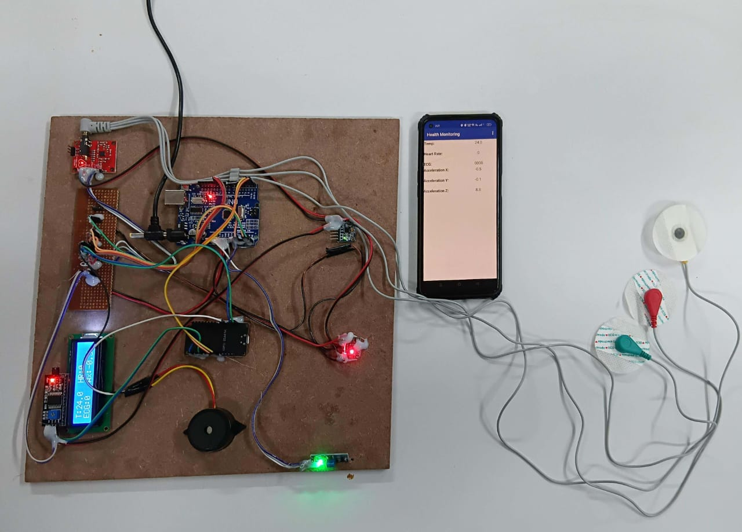
System Architecture
Arduino UNO preprocesses signals and sends data to ESP32.
ESP32 displays data locally and transmits to cloud via Wi-Fi.
Cloud platform stores data and provides dashboard access to users and healthcare providers.

Slide 7
Pulse Transit Time (PTT) Algorithm
PTT is time interval between ECG R-peak and PPG peak.
Used to estimate systolic and diastolic blood pressure non-invasively.
Eliminates need for inflatable cuffs.
Enables continuous and comfortable blood pressure monitoring.

Slide 8
Software and Data Communication
Arduino UNO acquires and preprocesses sensor data.
ESP32 handles wireless transmission using Wi-Fi.
Data sent securely to cloud server (using protocols like HTTPS or MQTT over TLS).
Real-time visualization on dashboard accessible via web or mobile.
Local display on ESP32 for immediate feedback.

Slide 9
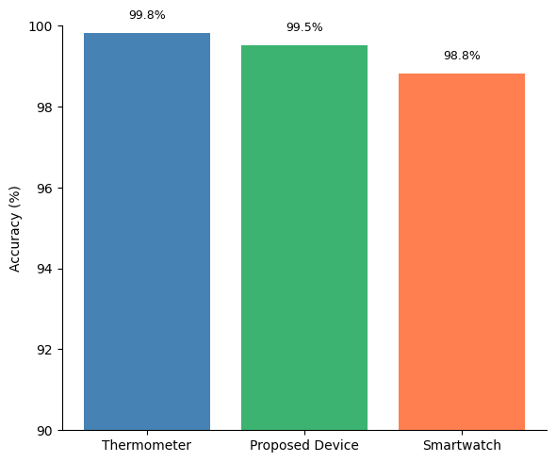
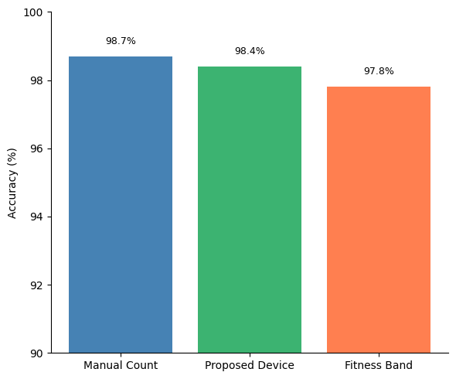
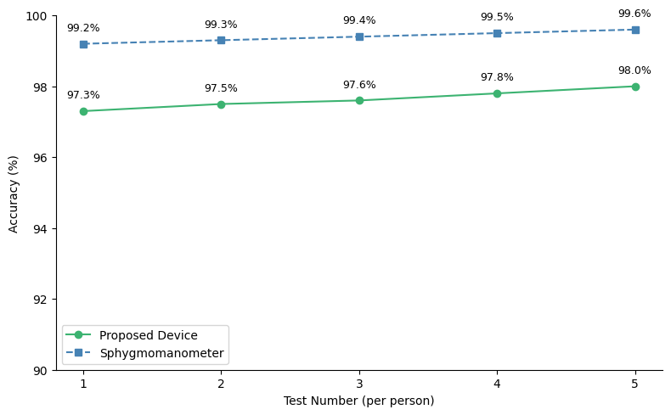
Experimental Results
Vital sign measurements validated against clinical standards.
Demonstrated accuracy for heart rate, temperature, and blood pressure.
Low power consumption suitable for battery operation.
Potential to reduce hospital readmissions via proactive monitoring.

Slide 10
Conclusion and Future Work
Developed a cost-effective, scalable, and energy-efficient IoT health monitoring system.
Non-invasive, continuous monitoring with multi-sensor integration.
Suitable for home care and rural healthcare applications.
Future enhancements: predictive analytics, additional sensors, improved cloud integration.

Slide 11
References
M. Neyja, S. Mumtaz, K. M. S. Huq, S. A. Busari, J. Rodriguez, and Z. Zhou, “An iot-based e-healthmonitoring system using ecg signal,” in 2017 IEEE Global Communications Conference (GLOBECOM),2017.
A. Abdelgawad, K. Yelamarthi, and A. Khattab, “Iot-based health monitoring system for active and as-sisted living,” in 2016 International Conference on Smart objects and Technologies for Social Good,2016.
N. M. Khoi, Saguna, K. Mitra, and C. ˚Ahlund, “Irehmo: An efficient iot-based remote health monitoringsystem for smart regions,” in 2015 17th International Conference on E-health Networking, Application &Services (HealthCom), 2015.
P. Singh, “Internet of things based health monitoring system: Opportunities and challenges,” InternationalJournal of Advanced Research in Computer Science, vol. 9, no. 1, 2018.
P. Valsalan, T. A. B. Baomar, and A. H. O. Baabood, “Iot based health monitoring system,” Journal ofCritical Reviews, vol. 7, no. 4, 2020.

